Slide 1
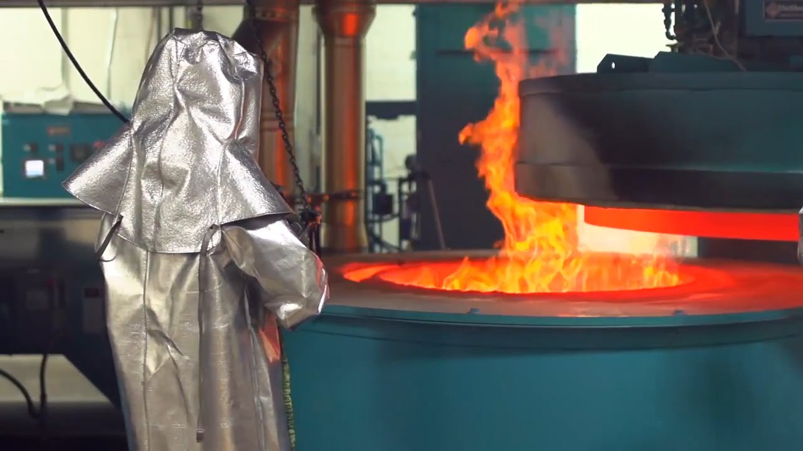
Heat treatment of metals Luis Alejandro Aguilera Ortiz 1838295 IMTC

Slide 2
What is the heat treatment?
Engineering properties are modified by heat treatment processes so that structural components are able withstand specified operating conditions and have desired useful life.
Heat treatment is the heating and cooling of metals to change their physical and mechanical properties, without letting it change its shape. Heat treatment could be said to be a method for strengthening materials but could also be used to alter some mechanical properties such as improving formability, machining, etc.

Slide 3
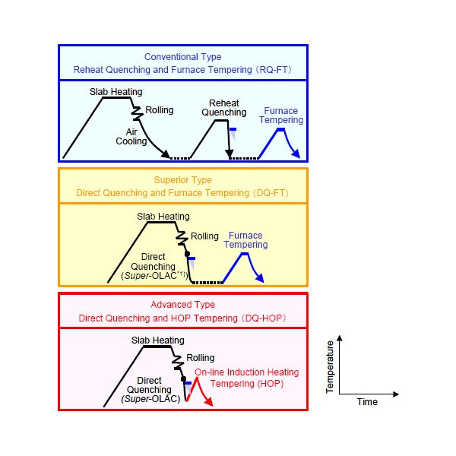
Heat treatment processes
Hardening
Tempering
Annealing
Normalizing
Carburization
Surface hardening

Slide 4
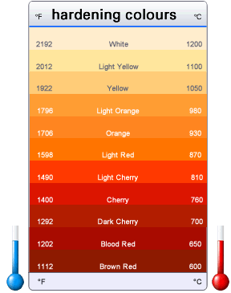
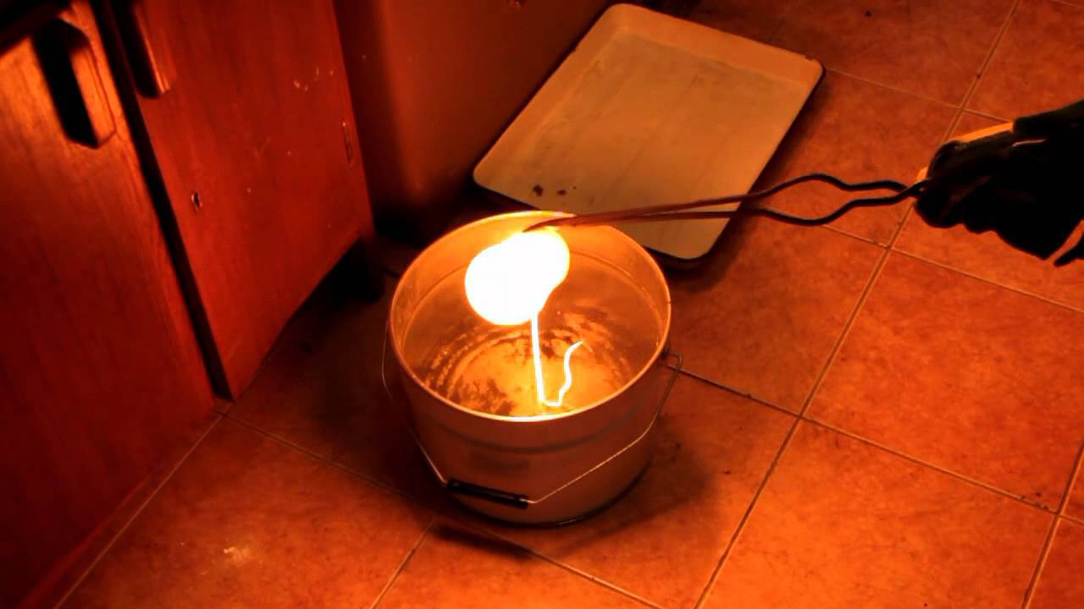
Hardening
Hardening involves heating of steel, keeping it at an appropriate temperature until all pearlite is transformed into austenite, and then quenching it rapidly in water or oil.
The heating time should be increased ensuring that the core will also be fully transformed into austenite.

Slide 5
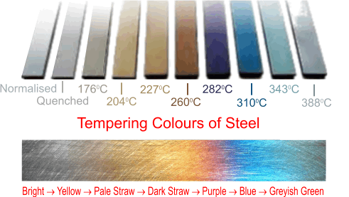
Tempering
Tempering involves heating steel that has been quenched and hardened for an adequate period of time so that the metal can be equilibrated. The hardness and strength obtained depend upon the temperature at which tempering is carried out. Higher temperatures will result into high ductility, but low strength and hardness. Low tempering temperatures will produce low ductility, but high strength and hardness.

Slide 6
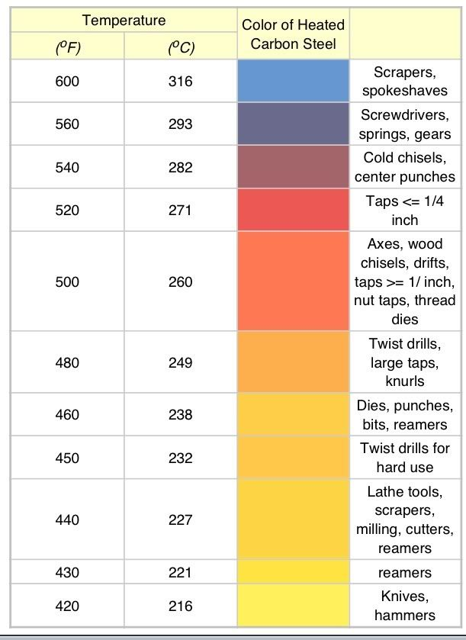

Slide 7
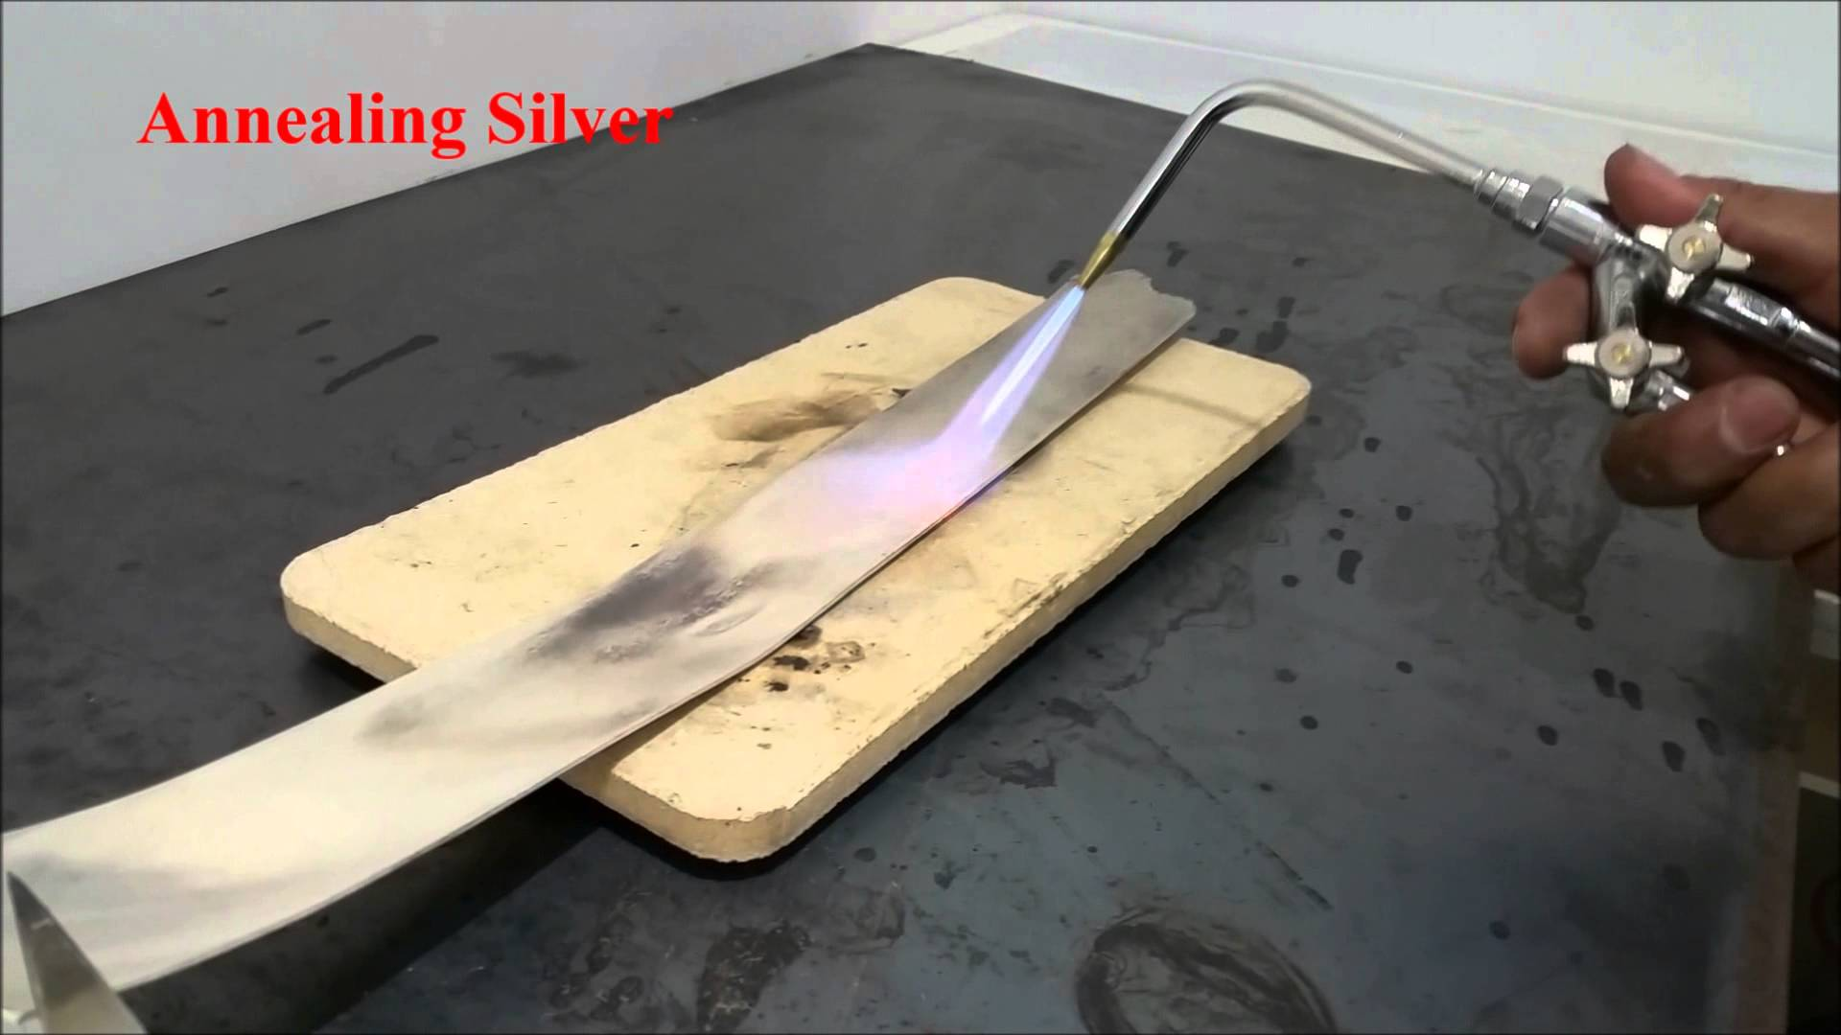
Annealing
Annealing is frequently used to soften metals including iron, steel, copper, brass and silver. The process involves heating the metal to a specific temperature then allowing it to cool slowly at a controlled rate.
Steel is annealed before being processed by cold forming, to reduce the requirements of load and energy, and to enable the metal to undergo large strains without failure.

Slide 8
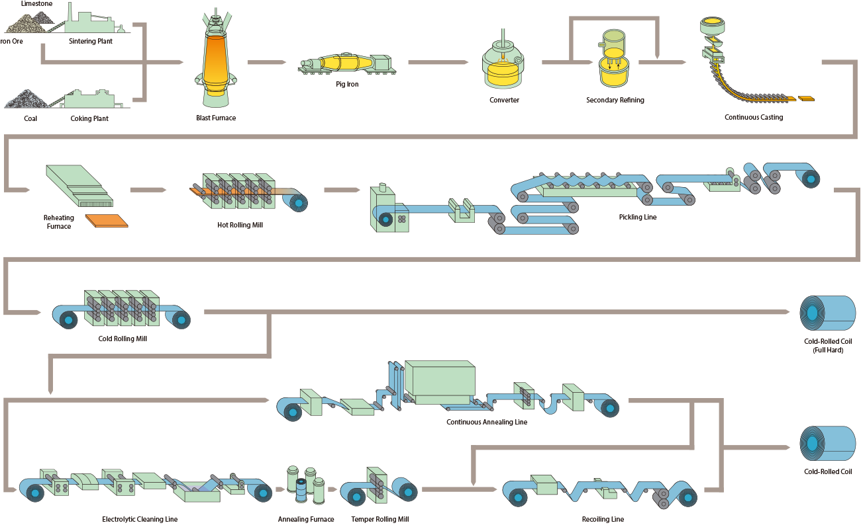

Slide 10
Normalizing
Normalizing involves heating steel, and then keeping it at that temperature for a period of time, and then cooling it in air.
The resulting metal is free of undesirable impurities and exhibits greater strength and hardness. Normalising is often used to produce a harder and stronger steel, albeit one that is less ductile than that produced by annealing.

Slide 11
Carburization
Carburization is a heat treatment process in which iron or steel absorbs carbon while the metal is heated in the presence of a carbon-bearing material, such as charcoal or carbon monoxide. The intent is to make the metal harder. Depending on the amount of time and temperature, the affected area can vary in carbon content. Longer carburizing times and higher temperatures typically increase the depth of carbon diffusion. When the iron or steel is cooled rapidly by quenching, the higher carbon content on the outer surface becomes hard due to the transformation from austenite to martensite, while the core remains soft and tough as a ferritic and/or pearlite microstructure.

Slide 12
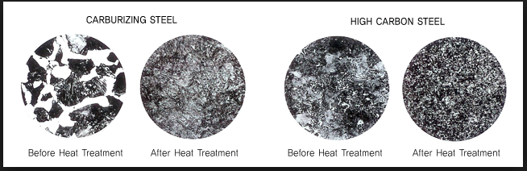
Carburizing steel

Slide 13
https://www.brighthubengineering.com/manufacturing-technology/30476-what-is-heat-treatment/
https://www.metalsupermarkets.com/how-heating-metal-affects-its-properties/
http://www.technologystudent.com/equip1/heat1.htm

